Slide 1
Fundacion Universitaria San Mateo Activity one independent moment My name is Karen Yuliana Muñoz Duran English course Year 2019

Slide 2
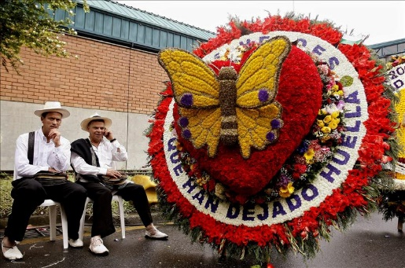

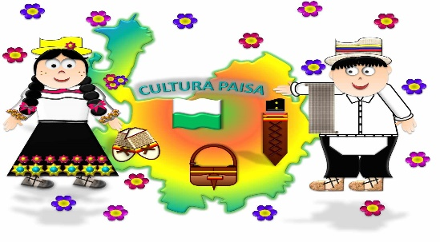
 |  |  | FLOWERS FLOWERS´ FLOWERS´ FESTIVAL
MONDAY | TUESDAY | WEDNESDAY | THURSDAY | FRIDAY | SATURDAY | SUNDAY
 |  |  | ONE | TWO | THREE | FOUR
FIVE | SIX | SEVEN | EIGHT | NINE | TEN FLOWER PARADE | ELEVEN OLD CARS´ PARADE
TWELVE | THIRTEEN | FOURTEEN | FIFTEEN | SIXTEEN | SEVENTEEN | EIGHTEEN
NINETEEN | TWENTY | TWENTY ONE | TWENTY -TWO | TWENTY -THREE | TWENTY -FOUR | TWENTY -FIVE
TWENTY -SIX | WENTY- SEVEN | TWENTY -EIGHT | TWENTY – NINE | THIRTY | THIRTY – ONE AZULEJO IS A LARGE BIRD.IT IS NATIVE .IT CAN LIVE INTO THE FOREST OR IN OUR CITY .ITS DIET IS SEEDS , DRY FRUITS AND WOMS.

Slide 3
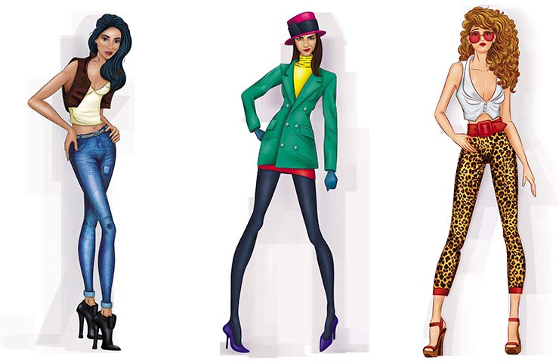


 |  |  | FASHION MONTH
MONDAY | TUESDAY | WEDNESDAY | THURSDAY | FRIDAY | SATURDAY | SUNDAY
ONE | TWO | THREE COLOMBIA MODA IS A EVENT TAKES PLACE EACH MONTH OF JULY. THE EVENT IS VERY IMPORTANT BECAUSE THERE ARE MANY FASHION COMPANIES PARTICIPATE THERE AND A LOT OF PEOPLE COME THERE, TOO. | FOUR | FIVE | SIX | SEVEN BARRANQUERO. OTHER COMMON NAME IS SOLEDAD. IT CAN EAT SPIDERS AND OTHERS INSECTS. ITS MAIN COLOR OF ITS BOBY IS BLUE. BARRANQUERO IS A BEAUTIFUL AND LARGE BIRD, THAT SAY THE PEOPLE.
EIGHT | NINE | TEN | ELEVEN | TWELVE | THIRTEEN | FOURTEEN
FIFTEEN | SIXTEEN | SEVENTEEN | EIGHTEEN | NINETEEN | TWENTY | TWENTY –ONE
TWENTY –TWO | TWENTY -THREE | TWENTY –FOUR | TWENTY –FIVE | TWENTY –SIX | TWENTY -SEVEN | TWENTY -EIGHT
TWENTY –NINE | THIRTY | THIRTY – ONE CLOSING: IN COLOMBIA MODA THE MODELS WEAR DIFFERENT CLOTHES

Slide 4
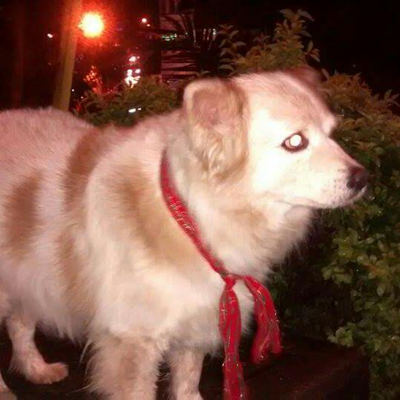

MY FAVORITE ANIMAL
HELLO MY NAME IS KAREN
My favorite animal is the dog. someone told me that animals can not feel love, the people say that the animals only follow their instinct, that’s true, but in my opinion, I think to have a dog is the best experience that a human can live.
SPANISH TRANSLATION
Hola mi nombre es Karen
Mi animal favorito es el perro. alguien me dijo que los animales no pueden sentir amor, la gente dice que los animales solo siguen su instinto, eso es cierto, pero en mi opinión, creo que tener un perro es la mejor experiencia que un humano puede vivir.
ENGLISH AUDIO

